Slide 1

New Forms of Data and the Analysis of Cities
Patrick Ballantyne, University of Liverpool
P.Ballantyne@liverpool.ac.uk

Slide 2

About Me
Postdoctoral Research Fellow:
Geographic Data Science Lab, University of Liverpool
Research Interests:
Retail, COVID-19, Geodemographics,
Consumer, Location and Mobility Data
New Forms of Data and the Analysis of Cities

Slide 3
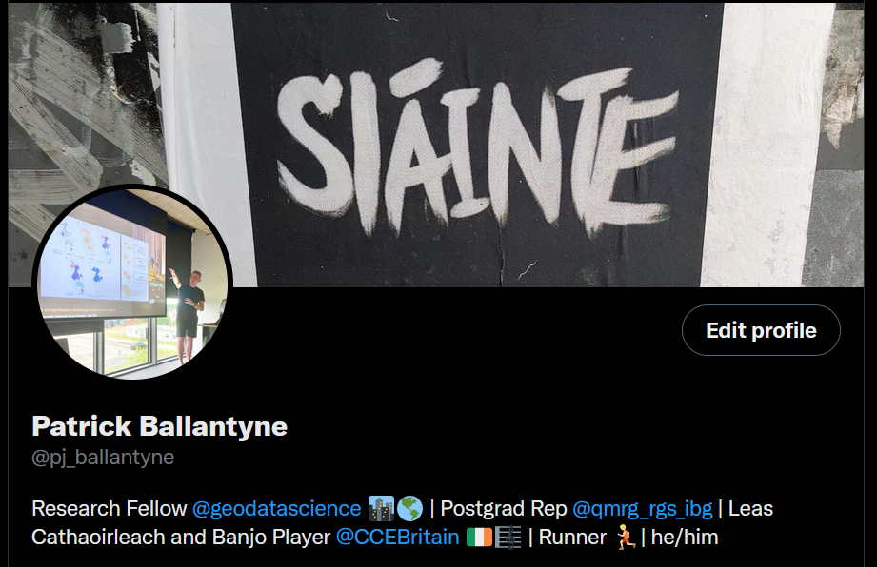
About Me
New Forms of Data and the Analysis of Cities

Slide 4
Overview
New Forms of Data and the Analysis of Cities

Slide 5
Overview
Cities; form and function
New forms of data
Data = insights
Case Study; Consumption Spaces
New Forms of Data and the Analysis of Cities

Slide 6

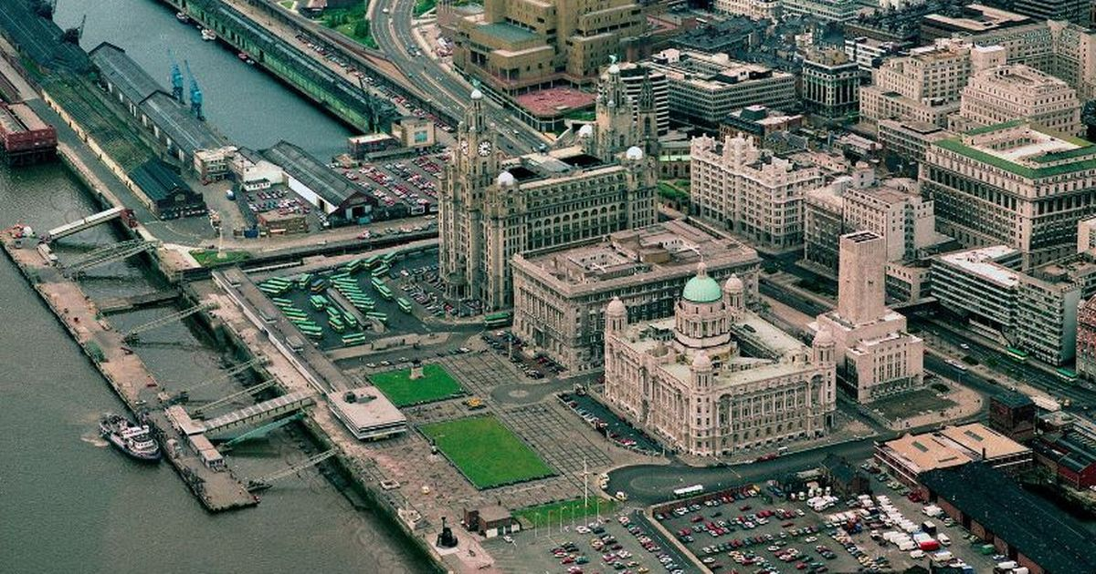
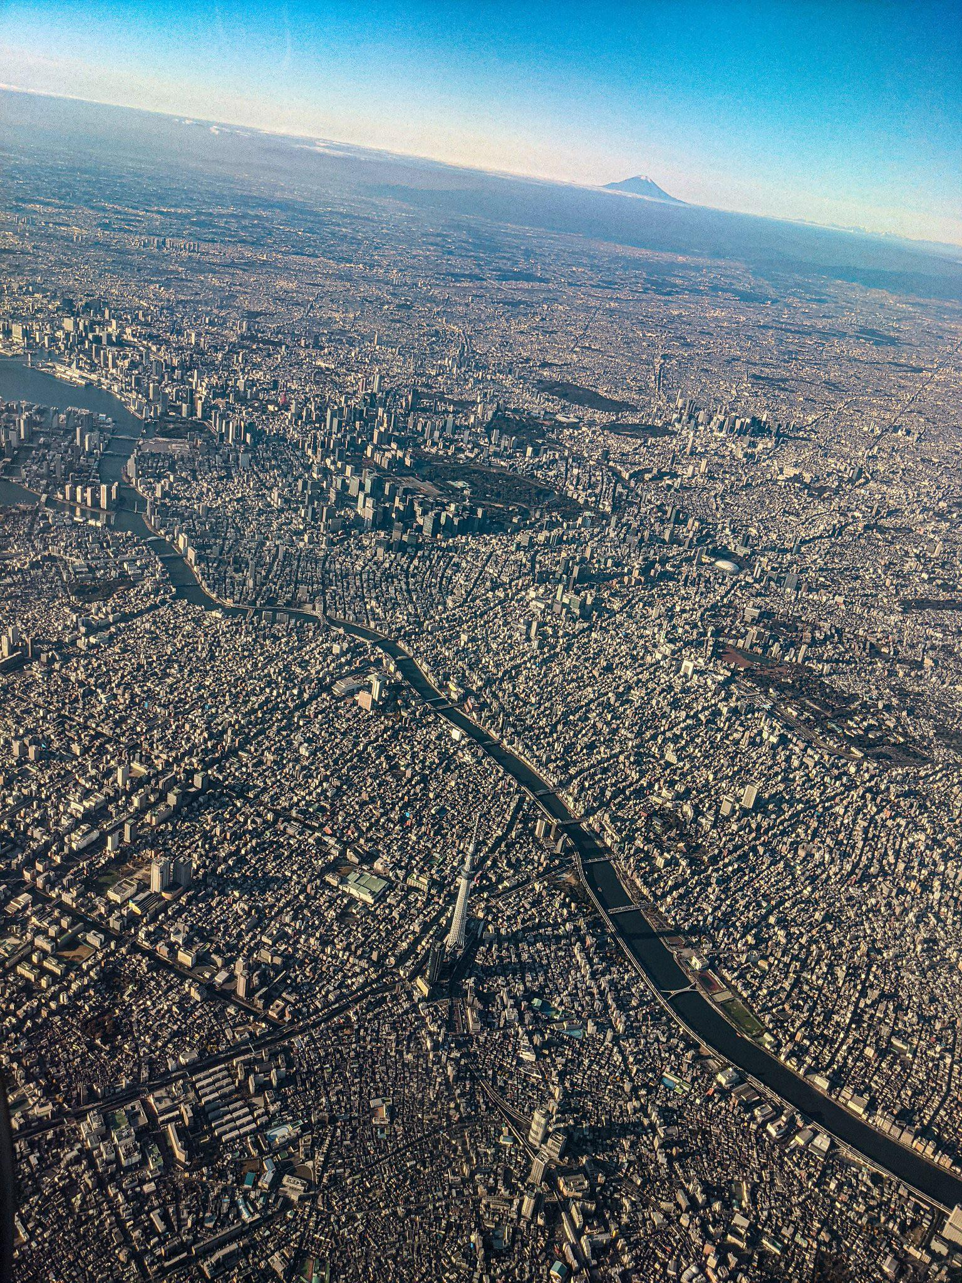
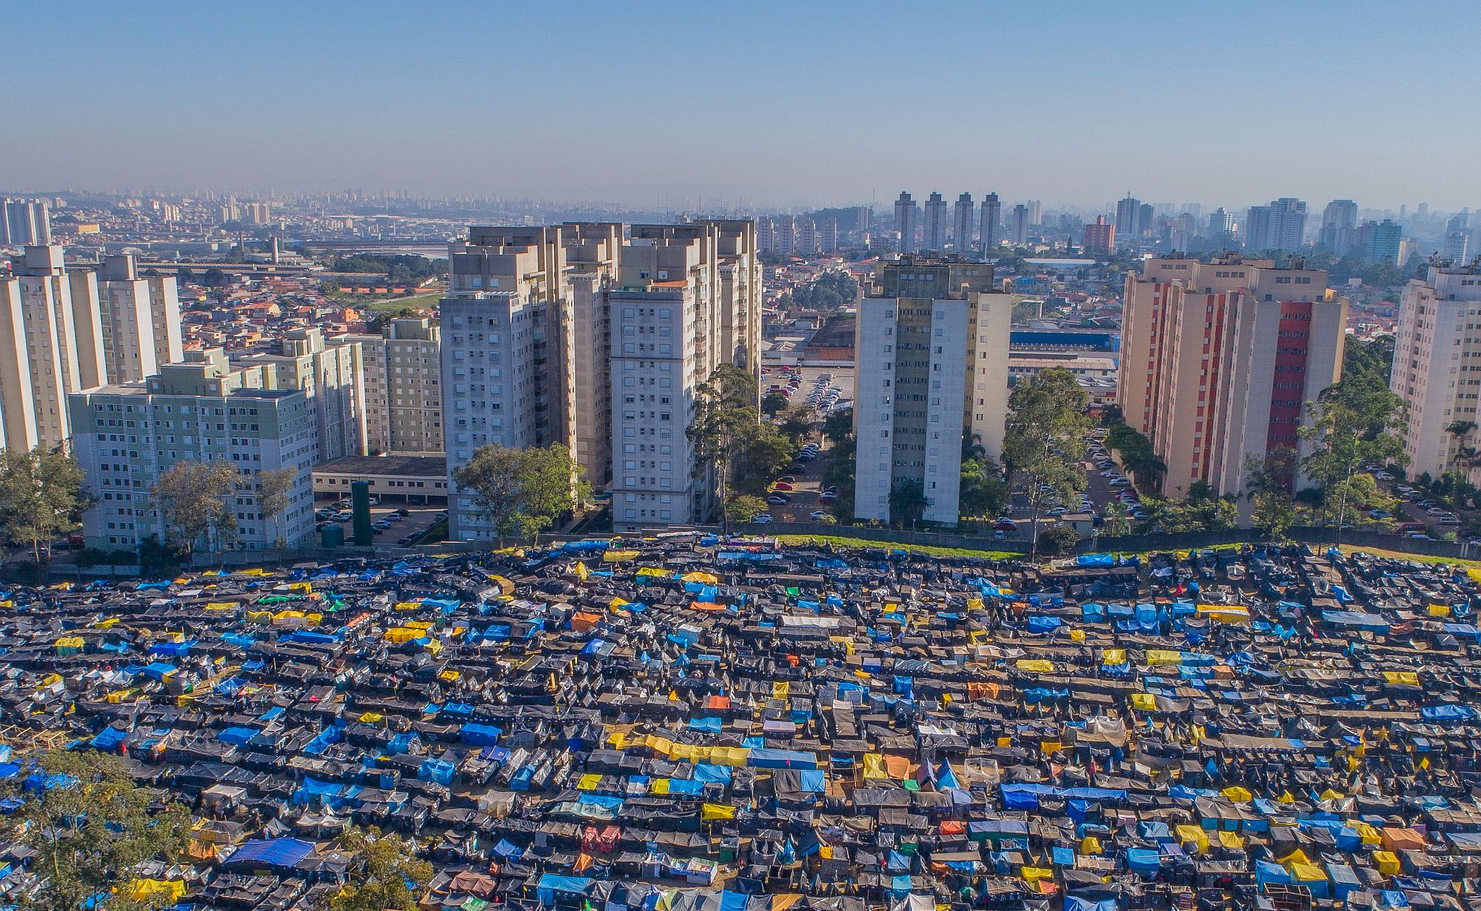
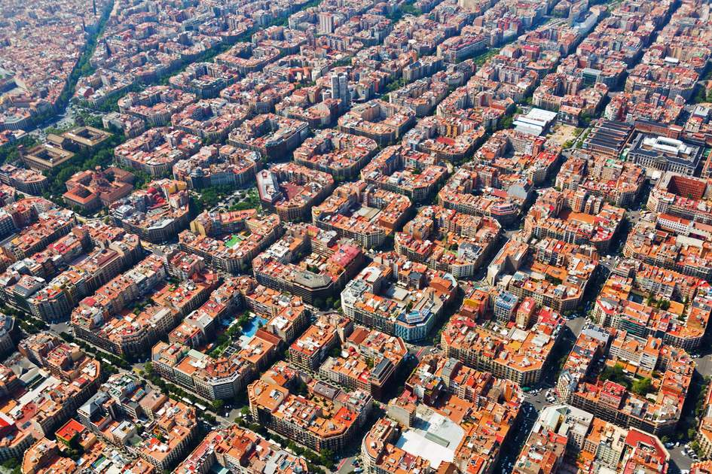
Cities
Tokyo, Japan
London, UK
Liverpool, UK
Sao Paulo, Brazil
New Forms of Data and the Analysis of Cities
Barcelona, Spain

Slide 7
Cities
Urban Form and Function
New Forms of Data and the Analysis of Cities

Slide 8
Cities
Urban Form and Function
“The shape and/or structure of anything...”
New Forms of Data and the Analysis of Cities

Slide 9
Cities
“The natural, proper or characteristic action of anything...”
Urban Form and Function
“The shape and/or structure of anything...”
New Forms of Data and the Analysis of Cities

Slide 10
Cities
Tokyo, Japan
London, UK
Liverpool, UK
Sao Paulo, Brazil
New Forms of Data and the Analysis of Cities
Barcelona, Spain

Slide 11
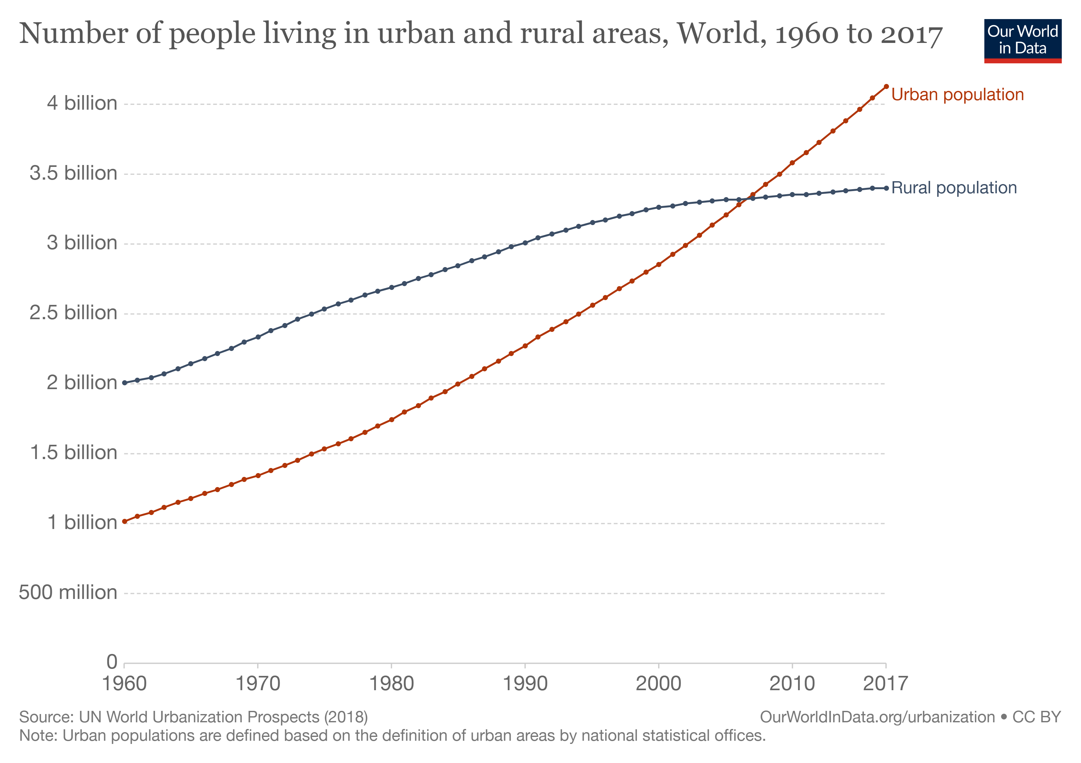
Cities Matter!
Over 50% of the world’s population live in cities...
New Forms of Data and the Analysis of Cities
Notes:
Other concepts;
They only cover about 1% of the earth’s surface; thus, they do not take up as much space as you would think.
They are responsible for 70% of global CO2 emission; climate change agenda.
Geographical phenomena, linked with all sorts of socio-economic, geo-political and environmental issues.

Slide 12

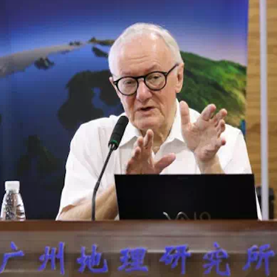
Cities Are Complex!
“Cities are largely unpredictable because they are complex systems that are more like organisms than machines. Neither the laws of economics nor the laws of mechanics apply; cities are the product of countless individual and collective decisions that do not conform to any grand plan. They are the product of our inventions; they evolve”.
New Forms of Data and the Analysis of Cities

Slide 13
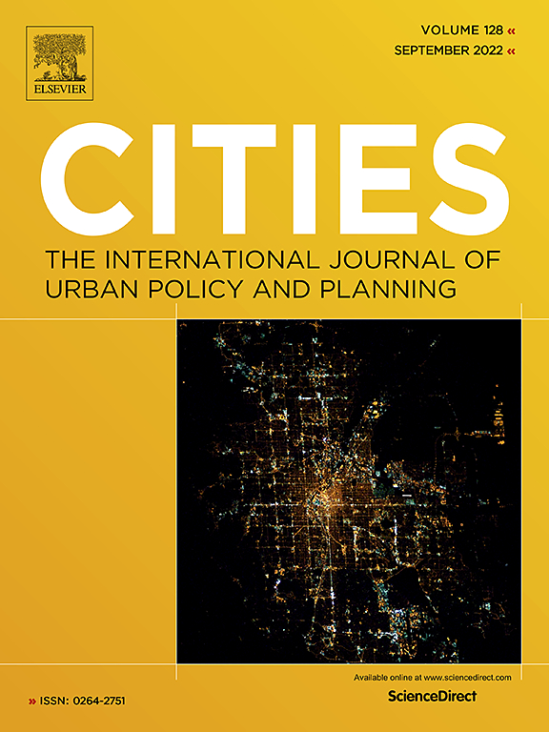



Cities Are Complex!
And many more...
New Forms of Data and the Analysis of Cities

Slide 14
Overview
Cities; form and function
New forms of data
Data = insights
Case Study; Consumption Spaces
New Forms of Data and the Analysis of Cities

Slide 15
Overview
Cities; form and function
New forms of data
Data = insights
Case Study; Consumption Spaces
New Forms of Data and the Analysis of Cities

Slide 16
Overview
Cities; form and function
New forms of data
Data = insights
Case Study; Consumption Spaces
New Forms of Data and the Analysis of Cities

Slide 17
New Forms of Data and the Analysis of Cities
Patrick Ballantyne, University of Liverpool
P.Ballantyne@liverpool.ac.uk

